Slide 1
Introduction to Statistics with
Navid Nobani – November 2017

Slide 2
Inferential and Descriptive Statistics
Why we need to divide field of statistics into Descriptive and Inferential?
It depends on the purpose of the research you’re conducting:
If you’re trying to generalize observed statistics in the sample to the population and increase your knowledge about the population you took the sample from, it’s inferential statistics. (target : reach some conclusions about Population)
If you don’t care about the population but instead want to know what is happening in the sample, it’s called descriptive statistics ( target: describe the sample)

Slide 3
Variable types
There are four types of variables:
Nominal (Ex. Gender, Race )
Ordinal ( Ex. Top richest people in Europe)
Interval (Ex. Likert Scale)
Ratio (Ex. Income, Temperature)
 | Order | Distance | Zero
Nominal
Ordinal | ✓
Interval | ✓ | ✓
Ratio | ✓ | ✓ | ✓

Slide 4
Measures of central tendency
Measuring the central tendency means describing the whole dataset( sample or population) with a single value.
There are 3 main measures of central tendency which depending on the situation can or cannot be used in the analysis Process:
Mean [mean(x, trim = 0, na.rm = FALSE, ...)]
Median [median(x, na.rm = FALSE)]
Mode [mode(x)]
Median formula is from formulas.tutorvista.com

Slide 5
Measures of Variability
Why central tendency need to be accompanied with variability in our reports ?
Like central tendency , there are 3 main measures for data variability:
Range [max(X) − min(X)]
Variance
Standard Deviation

Slide 6
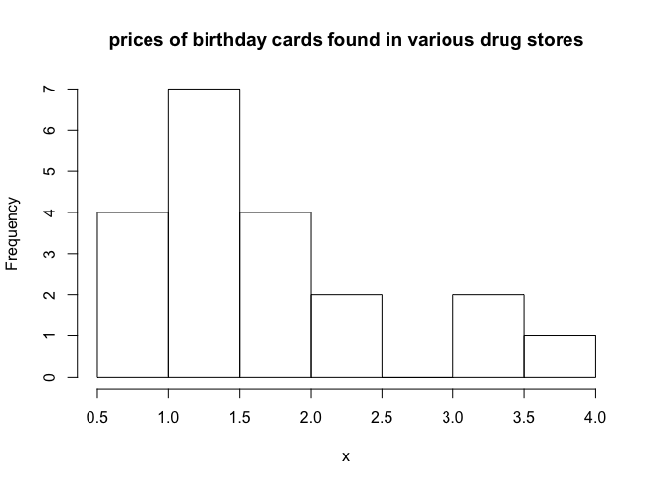
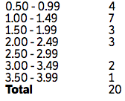
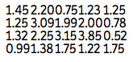
Graphic representations of data
Histogram: How is made
Choose your bin size
Count how many data points you have in each bin
Draw a rectangle for each bin with the height equal to frequency (from step 2)
Data : www.sparknotes.com

Slide 7
Graphic representations of data
Boxplot: How to construct a boxplot
1- Find the Min and Max of data
2- Find the Q2, Q1 and Q3 of data
3- Calculate the IQR
4- put everything together :D
Image: http://visualoop.com/blog/32470/a-look-at-box-plots
Image: David’s Statistics

Slide 8
Variance
The variance (σ²) is a measure of how far each value in the data set is from the mean [var(x)]
Var(X)=E(X​²​​)−E(X)​²​​
Formulas: www.sciencebuddies.org

Slide 9
Standard Deviation
Depending on if we’re analyzing the population or a sample from it, the standard deviation formula slightly changes:
For sample : [sd(X)]
For population : [sqrt((n-1)/n) * sd(x)]
Bassel’s correction
Image: commons.wikimedia.org

Slide 10
Variance, Covariance and beyond!
Univariate Statistics
Bivariate Statistics
Standard Deviation
Variance
Covariance
Autocorrelation
Correlation

Slide 11
Covariance
Covariance provides a measure of the strength of the correlation between two or more sets of random variates. [cov(x)]
COV (X, Y) = E(XY)−E(X)E(Y)
Definition: mathworld.wolfram.com

Slide 12
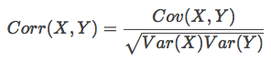
Correlation
Correlation is a well-behaved covariance! [cor(x) or cor.test(x) ]
Pearson Correlation
Cauchy-Schwarz inequality
Pearson Correlation is not the only statistics for measuring the strength of association between two variables
There are other guys like:
Kendall rank correlation
Spearman correlation
Point-Biserial correlation

Slide 13
Simple Regression
What is the aim of using a regression model?
How to calculate a simple regression
What are intercept, coefficient
How to evaluate the model using R-Squared?
Is there a minimum R-squared we should seek?

Slide 14
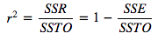
R-Squared
r² (R² in case of Multiple regression) or The Coefficient of Determination is a measure of goodness-of-fit.
It is simply is the proportion of the variation in the dependent variable that is predictable from the independent variable(s) or how much better you model is able to predict comparing to a Naïve model (in this case average)
Formula: onlinecourses.science.psu.edu

